Slide 1
Review for CITS 4401/3301

Slide 2
Software Requirements

Slide 3
Week 1
Different people:
Stakeholders
Users
customers
User stories: idea to capture user needs

Slide 4
Week 2: Requirement Engineering
Activities in requirement engineering:
Requirement elicitations
Requirement analysis
Requirement specification
Requirement validation
Related technologies

Slide 5
Week 3: Requirements analysis
Functional requirements: testable/feasible, align with the projects (should be not too general)
Non-functional requirements: could be improved by different refactoring techniques
Use case diagram
Use case

Slide 6
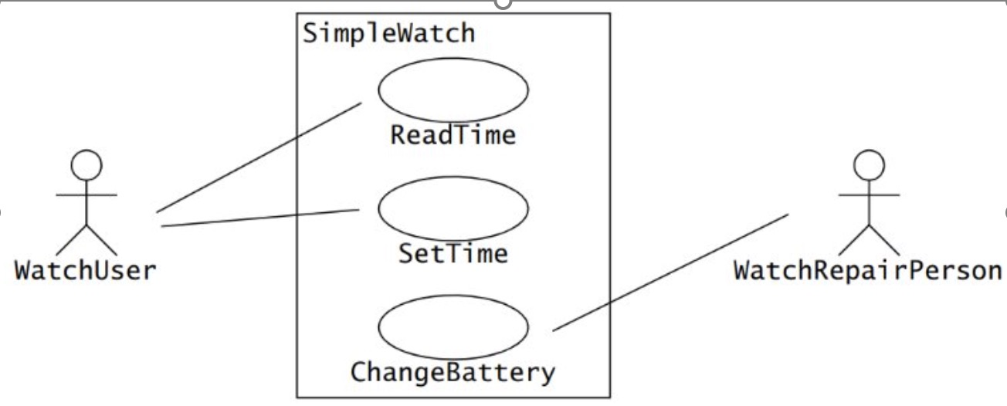
Notes:
These describe functionality of a system from the users’ point of view ​
​
They show functions that produce a visible result for an actor
Use case diagrams are a functional model, which used during the requirement elicitation and analysis.​
​
It basically describes functionality of a system from the users point of view – those that produce a visible result for an actor​
​
The actors are outside the boundary of the system whereas the use cases are inside the boundary of the system
---------
What components do you see here?​
Stick people = Actors​
Bubbles = functions (use cases)​
Box = System boundary​
​
Actors: Actors represent the different types of users or external systems that interact with the software. Actors could be individuals, groups of users, or other systems. They are depicted outside the system boundary in the diagram.​
​
Use Cases: Use cases represent the specific functionalities or tasks that the system provides to its users. They describe the interactions between the actors and the system to achieve a particular goal or task. Each use case typically represents a specific user goal or task. Use cases are depicted inside the system boundary, and they are connected to the actors that initiate them with lines called associations.​
​
System Boundary: The system boundary represents the scope of the system. It defines what is included within the system and what is external to it. Use cases and actors are positioned within or outside the system boundary to indicate their relationship to the system.​
​
Relationships: Use case diagrams may also show relationships between use cases, such as generalization (inheritance) or inclusion (one use case includes another). These relationships help to organize and understand the interactions between different functionalities within the system.​
​

Slide 7
Use case: an abstraction that describes all possible scenarios involving the described functionality
Logon This use case starts when a Student accesses the University Web site. The system asks for, and the Student enters, the student ID and password.​
Select 'Create a Schedule‘ The system displays the functions available to the student. The student selects "Create a Schedule.“​
Obtain Course Information The system retrieves a list of available course offerings from the Course Catalog System and displays the list to the Student.​
Select Courses The Student selects four primary course offerings and two alternate course offerings from the list of available course offerings.​
Submit Schedule The student indicates that the schedule is complete. For each selected course offering on the schedule, the system verifies that the Student has the necessary prerequisites.​
Display Completed Schedule The system displays the schedule containing the selected course offerings for the Student and the confirmation number for the schedule.
Notes:
use cases are broader descriptions of all the possible scenarios related to a particular function.

Slide 8
Use case: an abstraction that describes all possible scenarios involving the described functionality
3. Unfulfilled Prerequisites, Course Full, or Schedule Conflicts ​
​
In Step 5 of the Basic Flow, Submit Schedule, if the system determines that prerequisites for a selected course are not satisfied, that the course is full, or that there are schedule conflicts, the system will not enroll the student in the course. A message is displayed that the student can select a different course. The use case continues at Step 4, Select Courses, in the basic flow
Notes:
This alternate flow occurs during Step 5 of the Basic Flow, which is the Submit Schedule process.​
​
If, during step 5, the system finds that:​
The student doesn't meet the prerequisites for a selected course,​
The course is already full, or​
There are conflicts with the student's schedule,​
Then, the system will not enroll the student in the course.​
​
Instead, it displays a message informing the student about the issue and prompts them to select a different course.​
​
The use case then continues at Step 4, Select Courses, in the basic flow.​
In simpler terms, if the student tries to submit their schedule but there are problems like missing prerequisites, full courses, or schedule conflicts, the system won't let them enroll in those courses. Instead, it tells them about the issue and lets them choose other courses. This ensures that the student can make informed decisions about their course selections and helps them avoid problems with their schedule.
--------
Ok, lets quickly summarize what we have cover for this week.​
​
Writing a Use Case Involves Work:​
When you write a use case, you're basically describing how a user interacts with the system to achieve something.​
It's a detailed process that requires careful attention to detail.​
Using Dialogs:​
Think of a use case as a conversation between the user (actor) and the system.​
Each step should describe what the user does and how the system responds.​
It's like writing a script for a play where the user and the system have their lines.​
Numbering and Titles:​
Each step in the use case should be numbered for clarity.​
It helps keep things organized and makes it easier to follow the sequence of events.​
Also, give your use case a clear title that describes what it's about.​
Alternate Flows:​
Sometimes, things don't go as planned, and that's where alternate flows come in.​
They show what happens when there are deviations from the main path.​
Alternate flows should clearly indicate where they start in the basic flow and where they lead.​
In summary, writing a use case involves creating a detailed conversation between the user and the system. Each step should be clear, numbered, and titled. And don't forget about alternate flows—they help cover situations when things don't go according to plan.

Slide 9
Week 4 Testable Requirements
Verifiable Requirements and Prototyping Requirements
Performance Speed​
Number of processed transactions per second​
User/event response time​
Screen refresh time​
Example 1: The system shall respond to user requests in < 1 second when the system is running at normal user load of <100 concurrent users.​

Slide 10
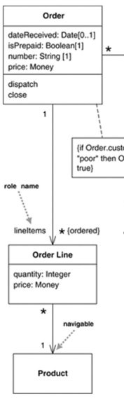
Week 5: Requirement Specification and Validation
Week 5: UML class diagram based on given scenarios
Dependency: two classes “use-a” temperate relationship to implement some functions (for example, when a method of one class takes an object of another class as a parameter) Week coupling
Association: a stronger relationship, two classes collaborate for a longer period of time (for example, a class has an attribute that is an instance of another class) Strong coupling

Slide 11
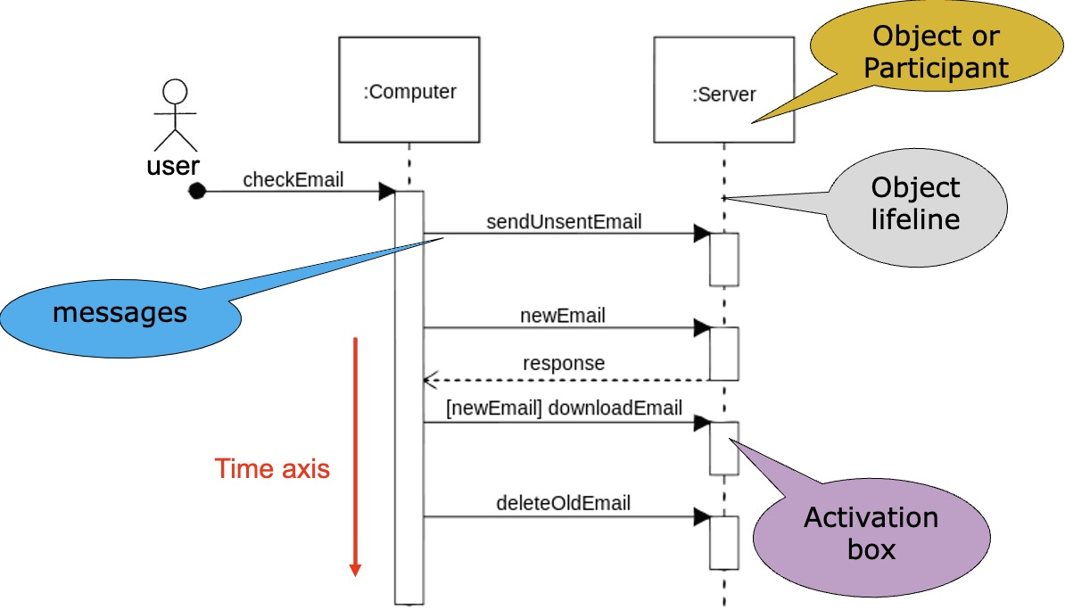
Week 6 Sequence and state diagrams
Notes:
​
The reason why they’re called sequence diagrams should be obvious: the sequential nature of the logic is shown via the ordering of the messages (the horizontal arrows). The first message starts in the top left corner, the next message appears just below that one, and so on.​
​
Explain the different components in the sequence diagrams.​
​
Time axis running vertically down​
Objects on the top, inside rectangular boxes​
Messages (horizontal arrows) are sent from sender object to receiver object​
Dashed horizontal arrows represent replies​
<<>>​
The dashed lines hanging from the boxes are called object lifelines, representing the life span of the object during the scenario being modeled. The long, thin boxes on the lifelines are activation boxes, which indicate processing is being performed by the target object/class to response a message.
How do you create the sequence diagrams. ​
​
Here are some conventions for us to follow: ​
​
1st Column - Actor: Imagine you're watching a play. The actor is like the main character who starts everything. In our case, it's the person or thing that initiates the action. So, in the first column, we list this initiator, just like listing the main character in a story.​
​
2nd Column - Boundary Object: Think of the boundary object. It's what the actor interacts with to get the action going. It's like the interface or gateway into the system. So, in the second column, we show this interaction point, where the action begins.​
​
3rd Column - Control Object: This is the control object. It manages what happens next after the action is initiated.. In the third column, we represent this controller, the one who manages the flow of the action.​
​
4th Column - Entity Object: Lastly, the entity object in the sequence diagram corresponds to the data that‘s stored in the database or other storage mechanism.

Slide 12
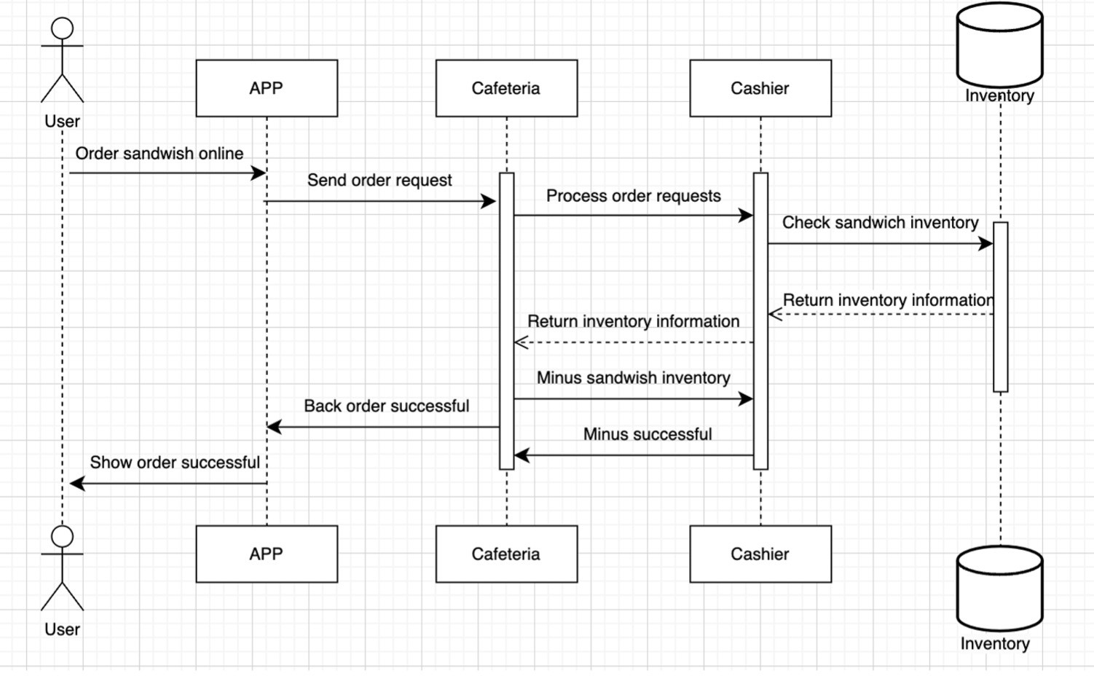
Some common issues:
missing some messages between objects.
object lifeline should be dashed lines
Some return messages are incorrect.
Other operations rather than login should be controlled by the “control entity”
Missing Activation boxes.
Only one actor should be interacting with the system
Messages are potentially method calls, open the application is not a method
Notes:
4.2 has distributed control. In a distributed control system, various entities may have independence in making decisions and coordinating their actions, potentially leading to a more decentralized and flexible architecture.​
​
4.1 has centralised control by the Order. In other words, the Order object takes on the primary responsibility for making decisions and coordinating actions within the system. It acts as a central point of control, directing the flow of operations and orchestrating interactions between different components or entities.

Slide 13
System Design

Slide 14
Week 7: Intro to System design
In system design, objects identified during analysis are grouped into subsystems.​
​
The degree of cohesion within and coupling between subsystems can be used to guide subsystem decomposition.

Slide 15
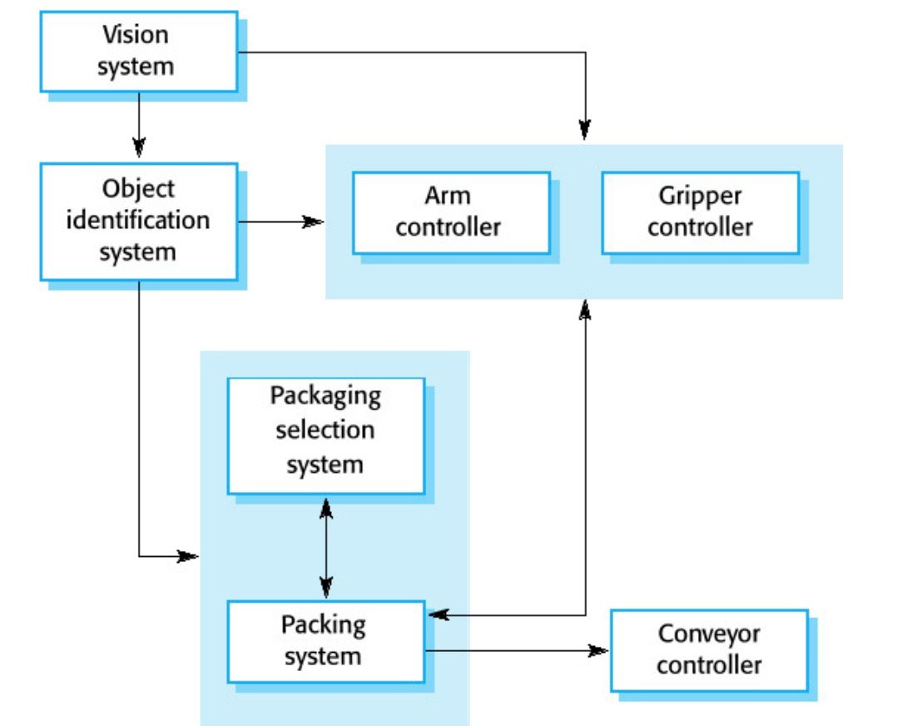
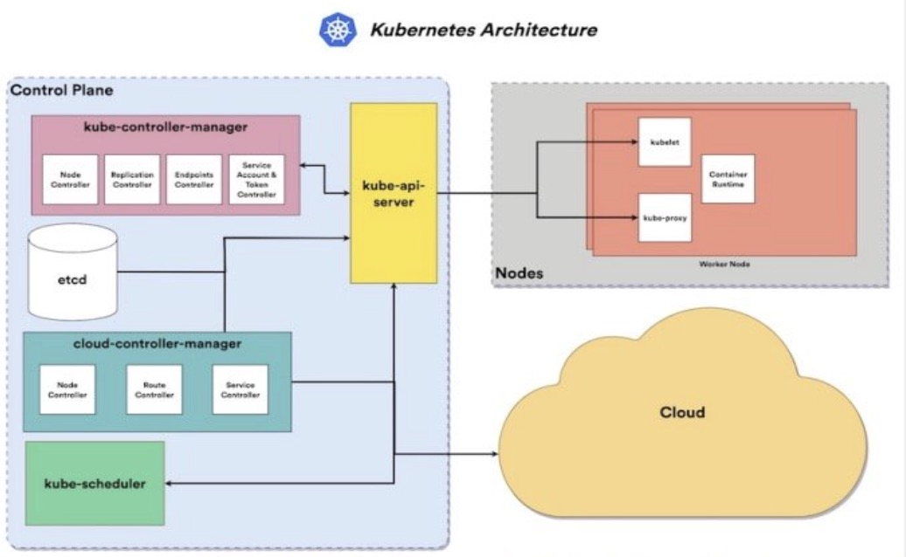
Notes:
​ "System Decomposition" is like breaking down a big task into smaller, more manageable parts. Imagine you have a big project to complete, like building a house. Instead of trying to do everything at once, you divide the project into smaller tasks, like laying the foundation, building the walls, and installing the roof.​
​
in system decomposition, we take a complex system, break it down into smaller components or modules. Each component focuses on a specific function or aspect of the system. This makes the system easier to understand, design, and manage.​
​
​ Let's break down each component of the robotic system for packing in a factory:​
Vision System:​
The vision system is like the eyes of the robot. It captures images or video of the objects in the packing area. This information is used to identify items, their positions, and orientations.​
Object Identification System:​
This system processes the visual information from the vision system to recognize and identify the objects that need to be packed. It might use techniques like image processing or machine learning to classify objects.​
Arm Controller:​
The arm controller controls the movements of the robotic arm. It determines where the arm should go and how it should move to pick up objects, move them around, and place them in the packing area.​
Gripper Controller:​
The gripper controller manages the gripper or robotic hand attached to the arm. It controls the opening and closing of the gripper to grasp and release objects securely.​
Packing Selection System:​
This system determines the appropriate packaging materials and methods based on factors like the type, size, and shape of the objects being packed. It might select boxes, bags, or other containers and decide how to arrange items inside them.​
Packing System:​
The packing system carries out the physical process of placing objects into the selected packaging. It coordinates with the arm controller and gripper controller to handle objects and arrange them correctly in the packaging.​
Conveyor Controller:​
The conveyor controller manages the conveyor belt or other transportation system used to move objects through the packing area. It controls the speed and direction of the conveyor to ensure a smooth flow of items for packing.​
Each of these components plays a specific role in the overall robotic packing system, working together seamlessly to efficiently pack items in a factory setting.
---------
​
Simple and Informal Block Diagrams:​
Block diagrams are visual representations that use blocks or rectangles to represent entities (components or modules) and lines or arrows to represent relationships or interactions between them.​
These diagrams are simple and informal, meaning they don't have to follow strict rules or standards. They are easy to create and understand, making them widely used for documenting system decomposition.​
Entities and Relationships:​
In the context of system decomposition, "entities" refer to the components or modules that make up the system. Each entity represents a specific part of the system, such as a subsystem, component, or functionality.​
"Relationships" describe how these entities are connected or interact with each other. This could include dependencies, communications, data flows, or any other interactions between components.​
Documenting Decomposition:​
To document decomposition using simple block diagrams, you start by identifying the main entities or components of the system. These could be identified through requirements analysis or brainstorming sessions.​
Next, you represent each entity as a block or rectangle in the diagram. You might label each block with the name of the entity it represents.​
Then, you draw lines or arrows between the blocks to show relationships or interactions between entities. This could include dependencies, data flows, control flows, or any other connections between components.​
The resulting block diagram provides a visual overview of the system's decomposition, making it easier for stakeholders to understand the system's structure and functionality.​
Overall, simple and informal block diagrams are a practical and effective method for documenting system decomposition. They provide a clear and intuitive representation of the system's architecture, helping stakeholders to visualize and comprehend the system's design and organization.​

Slide 16
Coupling and Cohesion: Cohesion measures the dependence among classes ​
High cohesion: The classes in the subsystem perform similar tasks and are related to each other (via associations) ​
Low cohesion: Lots of miscellaneous and auxiliary classes, no associations ​
Coupling measures dependencies between subsystems ​
High coupling: Changes to one subsystem will have high impact on the other subsystem (change of model, massive recompilation, etc.) ​
Low coupling: A change in one subsystem does not affect any other subsystem

Slide 17
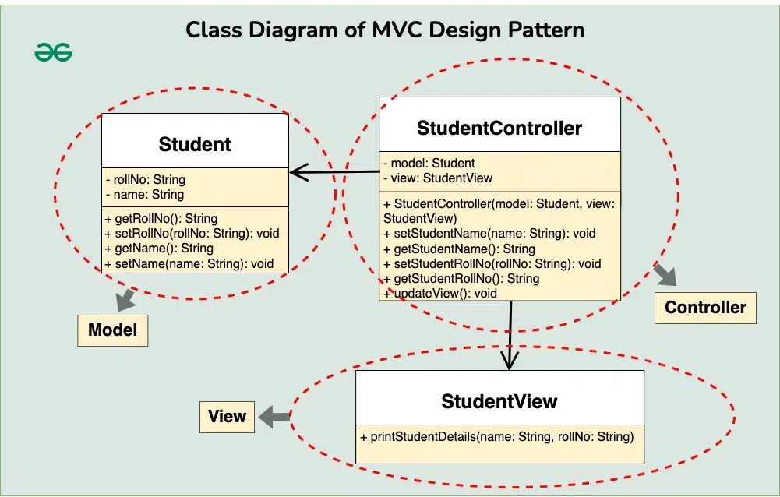
Week 8: Software Architecture
https://learn.microsoft.com/en-us/answers/questions/842217/mvc-based-system-modeling-and-architecture
Notes:
Architectural representations serve as essential tools for analyzing and describing the properties of complex systems. These representations provide a structured means of con/cep/tual/izing system components, interactions, and behaviors, facilitating comprehensive understanding and effective communication among stakeholders.
All software architectures have 3 common elements: ​
Components: a software system is made up of components, which are individual pieces of code responsible for specific tasks.​
Connectors: Think of connectors as the glue that holds the components together. They define how the components interact with each other. For example, a connector could be a procedure call, where one component invokes a function in another component, or it could be a database query, where one component retrieves information from a database used by another component.​
​
Constraints: Constraints are the rules or limitations that govern how the architecture is structured. These constraints could be technical limitations, like ensuring that certain components don't directly communicate with each other for security reasons, or they could be design principles, like ensuring that the architecture follows a certain pattern or doesn't contain any loops or cycles in its structure.
Represents the data (student’s name and roll number) and provides methods to access and modify this data.
Represents how the data (student details) should be displayed to the user. Contains a method (printStudentDetails) to print the student’s name and roll number.
Acts as an intermediary between the Model and the View. Contains references to the Model and View objects. Provides methods to update the Model (e.g., setStudentName, setStudentRollNo) and to update the View (updateView).

Slide 18
Week 9 Interfaces
What is interface design?​
HCI​
Hardware, Software​
API​
System design with interfaces: top down or bottom up

Slide 19
Week 10 Design Pattern
Understanding different design patterns
Is able to choose suite design patterns to solve the design problems.
Should NOT be very general explanations

